Slide 1
Data mining
Data mining is the process of sorting through large data sets to identify patterns and establish relationships to solve problems through data analysis. Data mining tools allow enterprises to predict future trends.

Slide 2
Market Basket Analysis
•Affinity analysis and association rule learning encompasses a broad set of analytics techniques aimed at uncovering the associations and connections between specific objects: these might be visitors to your website (customers or audience), products in your store, or content items on your media site.
•Of these, "market basket analysis" is perhaps the most famous example. In a market basket analysis, you look to see if there are combinations of products that frequently co-occur in transactions. For example,
maybe people who buy flour and casting sugar, also tend to buy eggs (because a high proportion of them are planning on baking a cake).

Slide 3
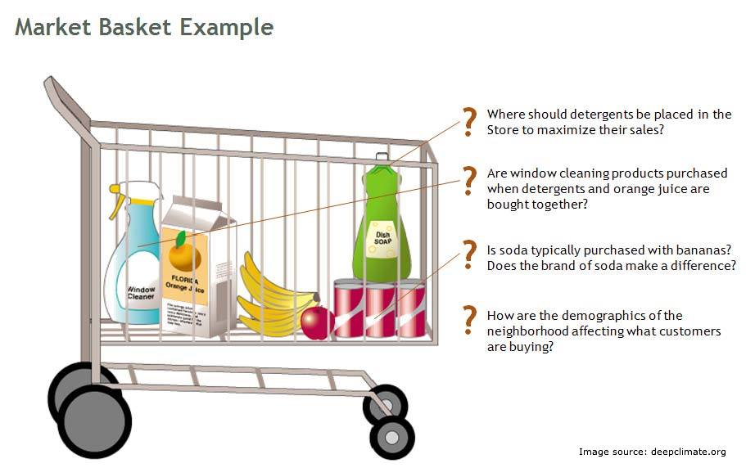

Slide 4
A retailer can use this information to inform:
1. Store layout
2. Marketing
3. Online retailers and publishers can use this type of analysis to:
1. Inform the placement of content items on their media sites, or products in their catalogue
2. Drive recommendation engines

Slide 5
•Items are the objects that we are identifying associations between. For an online retailer, each item is a product in the shop. For a publisher, each item might be an article, a blog post, a video etc. A group of items is an item set
.
•Transactions are instances of groups of items co-occurring together. For an online retailer, a transaction is, generally, a, transaction. For a publisher, a transaction might be the group of articles read in a single visit to the website. (It is up to the analyst to define over what period to measure a transaction.) For each transaction, then, we have an item set
•The output of a market basket analysis is generally a set of rules, that we can then exploit to make business decisions
MBA : Basics

Slide 6
•The support of an item or item set is the fraction of transactions in our data set that contain that item or item set. In general, it is nice to identify rules that have a high support, as these will be applicable to a large number of transactions. For super market retailers, this is likely to involve basic products that are popular across an entire user base (e.g. bread, milk). A printer cartridge retailer, for example, may not have products with a high support, because each customer only buys cartridges that are specific to his / her own printer.
•The confidence of a rule is the likelihood that it is true for a new transaction that contains the items on the LHS of the rule. (I.e. it is the probability that the transaction also contains the item(s) on the RHS.)
•The lift of a rule is the ratio of the support of the items on the LHS of the rule co-occurring with items on the RHS divided by probability that the LHS and RHS co-occur if the two are independent.

Slide 7
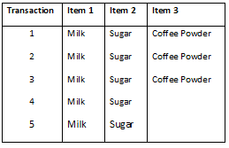
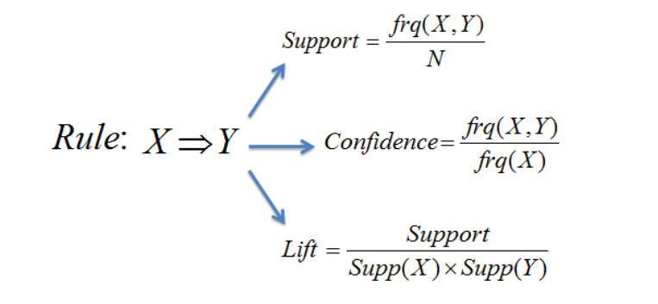

Slide 8
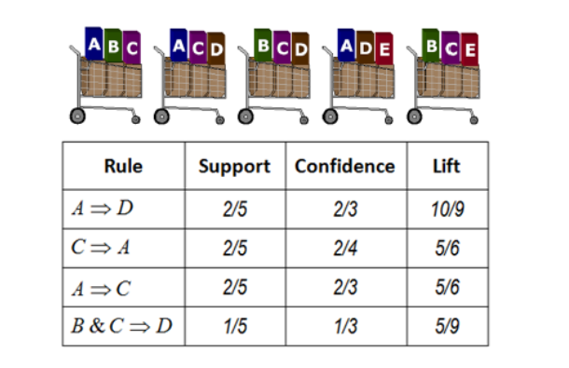

Slide 9
•When we perform market basket analysis, then, we are looking for rules with a lift of more than one.
•Rules with higher confidence are ones where the probability of an item appearing on the RHS is high given the presence of the items on the LHS.
• It is also preferable (higher value) to action rules that have a
high support -as these will be applicable to a larger number of transactions.
Support: how much product set is popular that it buyes by customer so many times
Confidence: It will gives confidence that how many customers will buy 2
Nd product if he/she buy product 1st.(50% conf means if there are 200 who buy
a then 100 will dfinitely buy b)
Lift: It indicate the strength of rule

